Slide 1
MTAT.03.231 Business Process Management Lecture 7 Quantitative Process Analysis
Part 2: Queueing Analysis & Simulation
Marlon Dumas
Professor of Information Systems @ University of Tartu
Co-Founder of Apromore

Slide 2
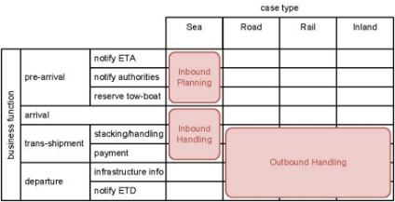
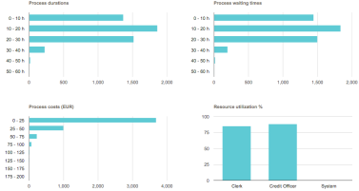

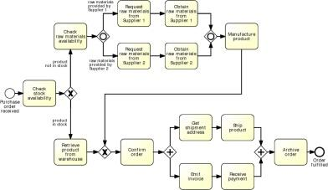
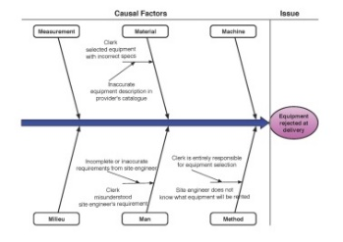
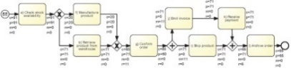
Process Analysis

Slide 3
Process Analysis Techniques
Qualitative analysis
Value-Added & Waste Analysis
Issue Register
Quantitative Analysis
Root-Cause Analysis
Pareto Analysis
Flow analysis
Queuing analysis
Simulation

Slide 4
Why flow analysis is not enough?
Flow analysis does not consider waiting times due to resource contention
Queuing analysis and simulation address these limitations and have a broader applicability

Slide 5
Queuing Analysis
Capacity problems are common and a key driver of process redesign
Need to balance the cost of increased capacity against the gains of increased productivity and service
Queuing and waiting time analysis is particularly important in service systems
Large costs of waiting and/or lost sales due to waiting
Example – ER at a Hospital
Patients arrive by ambulance or by their own accord
One doctor is always on duty
More patients seeks help ⇒ longer waiting times
Question: Should another MD position be instated?
© Laguna & Marklund: Business Process Modeling, Analysis and Design

Slide 6
Delay is Caused by Job Interference
If arrivals are regular or sufficiently spaced apart, no queuing delay occurs
Deterministic traffic
Variable but spaced apart traffic
© Dimitri P. Bertsekas
Notes:
Queuing occurs every time user demand exceeds server capacity.
Delays are due to several reasons. Let’s examine some of them…

Slide 7
Burstiness Causes Interference
Queuing results from variability in processing times and/or interarrival intervals
© Dimitri P. Bertsekas
Notes:
What does “bursty traffic” mean?

Slide 8
Job Size Variation Causes Interference
Deterministic arrivals, variable job sizes
© Dimitri P. Bertsekas
Notes:
Arrivals are deterministic (e.g. the intervals between 2 consecutive arrivals are always the same), however some jobs are longer than others

Slide 9
High Utilization Exacerbates Interference
The queuing probability increases as the load increases
Utilization close to 100% is unsustainable → too long queuing times
© Dimitri P. Bertsekas
Notes:
Delay probability is higher under heavy loading conditions than when the traffic is light

Slide 10
The Poisson Process
Common arrival assumption in many queuing and simulation models
The times between arrivals are independent, identically distributed and exponential
P (arrival < t) = 1 – e^{-λt}
Key property: The fact that a certain event has not happened tells us nothing about how long it will take before it happens
e.g., P(X > 40 | X >= 30) = P (X > 10)
© Laguna & Marklund
Notes:
A useful queuing model represents a real-life system with sufficient accuracy and is analytically tractable. A queuing model based on the Poisson process often meets these two requirements. A Poisson process models random events (such as a customer arrival, a request for action from a web server, or the completion of the actions requested of a web server) as emanating from a memoryless process. That is, the length of the time interval from the current time to the occurrence of the next event does not depend upon the time of occurrence of the last event
Independent increments: the numbers of occurrences counted in disjoint intervals are independent from each other
Stationary increments: the probability distribution of the number of occurrences counted in any time interval only depends on the length of the interval
Closed under Addiction and Subtraction

Slide 11
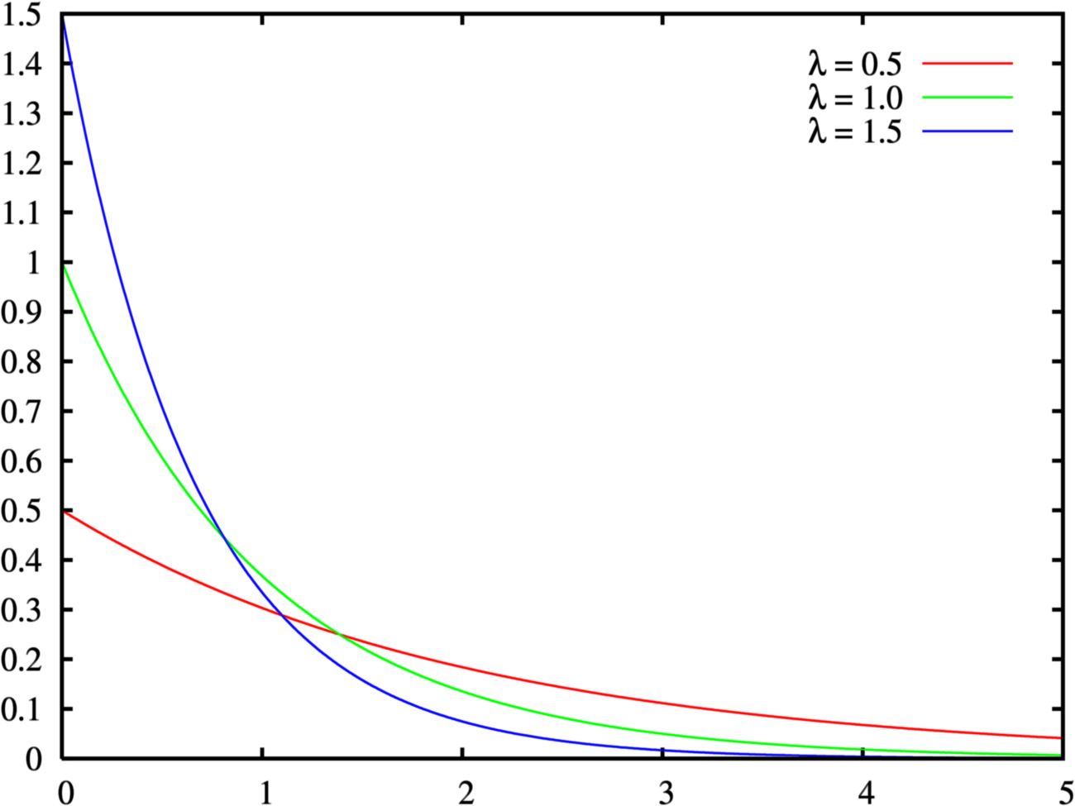
Negative Exponential Distribution

Slide 12
Queuing theory: basic concepts
waiting
service
arrivals
λ
c
μ
Basic characteristics:
λ (mean arrival rate) = average number of arrivals per time unit
μ (mean service rate) = average number of jobs that can be handled by one server per time unit:
c = number of servers
© Wil van der Aalst

Slide 13
Queuing theory concepts (cont.)
λ
c
μ
Wq,Lq
W,L
Given λ , μ and c, we can calculate :
ρ = resource utilization
Wq = average time a job spends in queue (i.e. waiting time)
W = average time in the “system” (i.e. cycle time)
Lq = average number of jobs in queue (i.e. length of queue)
L = average number of jobs in system (i.e. Work-in-Progress)
© Wil van der Aalst

Slide 14
M/M/1 queue
λ
1
μ
Assumptions:
time between arrivals and processing time follow a negative exponential distribution
1 server (c = 1)
FIFO
L=ρ/(1- ρ)
L_{q}= ρ²/(1- ρ) = L-ρ
W=L/λ=1/(μ- λ)
Wq=Lq/λ= λ /( μ(μ- λ))
© Laguna & Marklund

Slide 15
M/M/c queue
Now there are c servers in parallel, so the expected capacity per time unit is then c*μ
Little’s Formula ⇒ Wq=Lq/λ
W=Wq+(1/μ)
Little’s Formula ⇒ L=λW
© Laguna & Marklund

Slide 16
Tool Support
For M/M/c systems, the exact computation of Lq is rather complex…
These calculations can be done by a queuing theory calculator, e.g.
https://www.omnicalculator.com/math/queueing-theory
Select the option M/M/s and enter arrival rate, service rate, and number of servers

Slide 17
Example – ER at County Hospital
Situation
Patients arrive according to a Poisson process with intensity λ (⇔ the time between arrivals is exp(λ) distributed.
The service time (the doctor’s examination and treatment time of a patient) follows an exponential distribution with mean 1/μ (=exp(μ) distributed)
The ER can be modeled as an M/M/c system where c = the number of doctors
Data gathering
λ = 2 patients per hour
μ = 3 patients per hour
Question
Should the capacity be increased from 1 to 2 doctors?
© Laguna & Marklund

Slide 18
Queuing Analysis – Hospital Scenario
Interpretation
To be in the queue = to be in the waiting room
To be in the system = to be in the ER (waiting or under treatment)
Is it warranted to hire a second doctor ?
Characteristic | One doctor (c=1) | Two Doctors (c=2)
ρ | 2/3 | 1/3
Lq | 4/3 patients | 1/12 patients
L | 2 patients | 3/4 patients
Wq | 2/3 h = 40 minutes | 1/24 h = 2.5 minutes
W | 1 h | 3/8 h = 22.5 minutes
© Laguna & Marklund

Slide 19
Business Process Simulation
Versatile quantitative analysis method for
As-is analysis
What-if analysis
In a nutshell:
Run a large number of process instances
Gather performance data (cost, time, resource usage)
Calculate statistics from the collected data

Slide 20
Process Simulation
Model the process
Define a simulation scenario
Run the simulation
Analyze the simulation outputs
Repeat for alternative scenarios

Slide 21
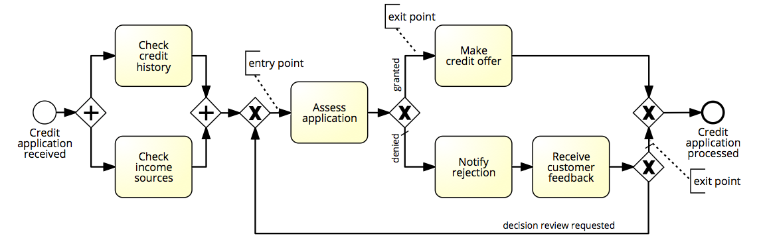
Example

Slide 22
Elements of a simulation scenario
Processing times of activities
Fixed value
Probability distribution

Slide 23
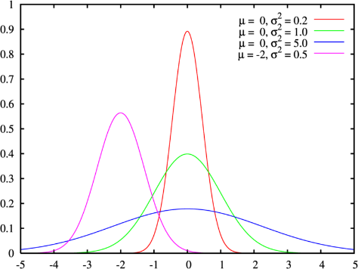

Choice of probability distribution
Fixed
Can be used to approximate cases where the activity processing time varies very little
Example: a task performed by a software application
Normal
Repetitive activities
Example: “Check completeness of an application”
Requires us to specify the mean and the std deviation
Exponential
Complex activities that may involve detailed analyses or decisions
Example: “Assess an application”
Requires us to specify the mean only
Notes:
Other distributions allowed by BIMP: Uniform, Triangular, Log-normal, Gamma…
Continuous uniform: the value is uniformely distributed in the interval between a and b. A value can be any between a and b
Discrete uniform distribution: a finite number of values are equally likely to be observed
Triangular: In probability theory and statistics, the triangular distribution is a continuous probability distribution with lower limit a, upper limit b and mode c, where a < b and a ≤ c ≤ b.
Log-normal: In probability theory, a log-normal (or lognormal) distribution is a continuous probability distribution of a random variable whose logarithm is normally distributed. Thus, if the random variable X {\displaystyle X} is log-normally distributed, then Y = ln ⁡ ( X ) {\displaystyle Y=\ln(X)} has a normal distribution. Likewise, if Y {\displaystyle Y} has a normal distribution, then X = exp ⁡ ( Y ) {\displaystyle X=\exp(Y)} has a log-normal distribution.
Gamma: In probability theory and statistics, the gamma distribution is a two-parameter family of continuous probability distributions. The common exponential distribution and chi-squared distribution are special cases of the gamma distribution.

Slide 24
Simulation sxample
Normal(10m, 2m)
Normal(10m, 2m)
0m
Exp(20m)
Normal(20m, 4m)
Normal(10m, 2m)

Slide 25
Elements of a simulation model
Processing times of activities
Fixed value
Probability distribution
Conditional branching probabilities
Arrival rate of process instances and probability distribution
Typically exponential distribution with a given mean inter-arrival time
Arrival calendar, e.g. Monday-Friday, 9am-5pm, or 24/7

Slide 26
Branching probability and arrival rate
Arrival rate = 2 applications per hour
Inter-arrival time = 0.5 hour
Negative exponential distribution
From Monday-Friday, 9am-5pm
0.3
0.7
0.3
9:00
10:00
11:00
12:00
13:00
13:00

Slide 27
Elements of a simulation model
Processing times of activities
Fixed value
Probability distribution
Conditional branching probabilities
Arrival rate of process instances
Typically exponential distribution with a given mean inter-arrival time
Arrival calendar, e.g. Monday-Friday, 9am-5pm, or 24/7
Resource pools
Notes:
Resource pools in this context is not to be confused with pools in BPMN. A resource pool here is simply a set of resources who can perform a given activity. A resource pool for example can be a role or a group. In a way resource pool in the context of simulation is closer to the notion of “lane” in BPMN and typically lanes in BPMN will become resource pools when we simulate the process.

Slide 28


Resource pools
Name
Size of the resource pool
Cost per time unit of a resource in the pool
Availability of the pool (working calendar)
Examples:
Clerk Credit Officer
€ 25 per hour € 35 per hour
Mon-Fri, 9am-5pm Mon-Fri, 9am-4pm
Notes:
To specify a resource pool we need of course to give it a name.
We also have to specify the size of the pool, meaning how many resources belong to it.
Finally, we
---
A resource pool in the context of simulation is specified by means of its name; the size of the resource pool, meaning the number of instances of that resource type; and the cost per time unit, say per hour or per day or per month of a given resource of that pool; and finally the availability of the pool, meaning during what calendar are the resources in the pool available.
An example of a resource pool could be for example a clerk, which corresponds to a role within the organisation. That clerk has a cost of 25 Euros an hour and works according to a calendar, Monday to Friday, nine to five. Another example could be a credit officer with a cost of each credit officer of 25 per hour and a calendar of Monday to Friday, nine to five.
In some simulation tools it is possible to define the cost and the calendar at the level of each individual resource rather than define it at the level of the resource pool. However in subsequent examples we’ll concentrate on the case where all the resources in a given pool have the same cost and abide to the same calendar.

Slide 29
Elements of a simulation model
Processing times of activities
Fixed value
Probability distribution
Conditional branching probabilities
Arrival rate of process instances and probability distribution
Typically exponential distribution with a given mean inter-arrival time
Arrival calendar, e.g. Monday-Friday, 9am-5pm, or 24/7
Resource pools
Assignment of tasks to resource pools

Slide 30


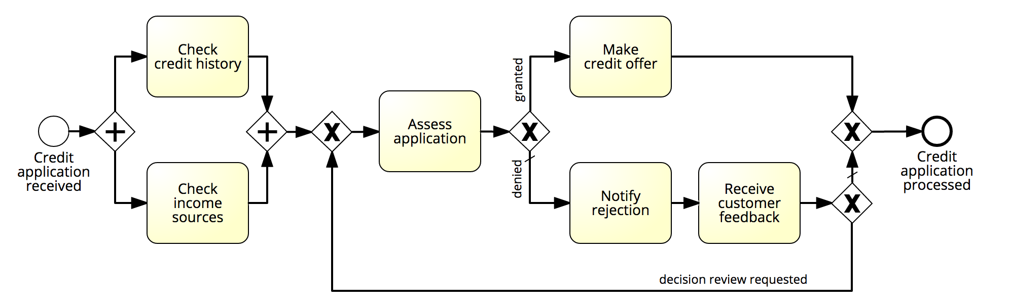

Resource pool assignment
Clerk
Officer
System
Officer
Clerk
Officer
Notes:
In our case for example we might say that check credit history is performed by a clerk, same for check income sources, whereas assess application, make a credit offer, and notify rejection are performed by a credit officer, while receive customer feedback is performed by the system.

Slide 31
Process Simulation
Model the process
Define a simulation scenario
Run the simulation
Analyze the simulation outputs
Repeat for alternative scenarios
✔
✔
✔

Slide 32
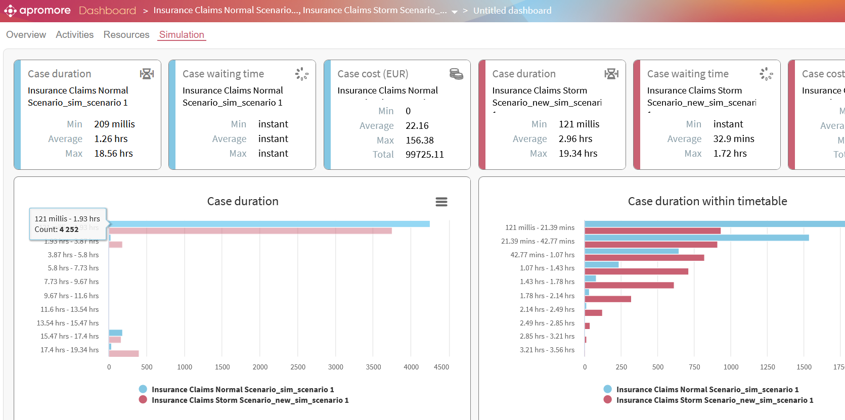
Output: Performance measures & histograms

Slide 33
Process Simulation
Model the process
Define a simulation scenario
Run the simulation
Analyze the simulation outputs
Repeat for alternative scenarios
✔
✔
✔
✔

Slide 34
Tools for Process Simulation
Apromore
ARIS
Bizagi Process Modeler (cloud edition)
iGrafx
…

Slide 35
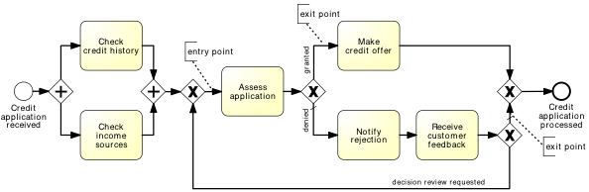
Demo: Simulation in Apromore

Slide 36
Pitfalls of simulation
Stochasticity
Data quality
Simplifying assumptions

Slide 37
Stochasticity
Problem
Simulation results may differ from one run to another
Solutions
Make the simulation timeframe long enough to cover weekly and seasonal variability, where applicable
Use multiple simulation runs, average results of multiple runs, compute confidence intervals
Multiple simulation runs
Average results of multiple runs
Compute confidence intervals

Slide 38
Data quality
Problem
Simulation results are only as trustworthy as the input data
Solutions:
Rely as little as possible on “guesstimates”. Use input analysis where possible:
Derive simulation scenario parameters from numbers in the scenario
Use statistical tools to check fit the probability distributions
Simulate the “as is” scenario and cross-check results against actual observations

Slide 39
Simulation simplifying assumptions
That the process model is always followed to the letter
No deviations
No workarounds
That a resource only works on one task
No multitasking
That if a resource becomes available and a work item (task) is enabled, the resource will start it right away
No batching
That resources work constantly (no interruptions)
Every day is the same!
No tiredness effects
No distractions beyond “stochastic” ones

Slide 40
Next week

